Slide 1
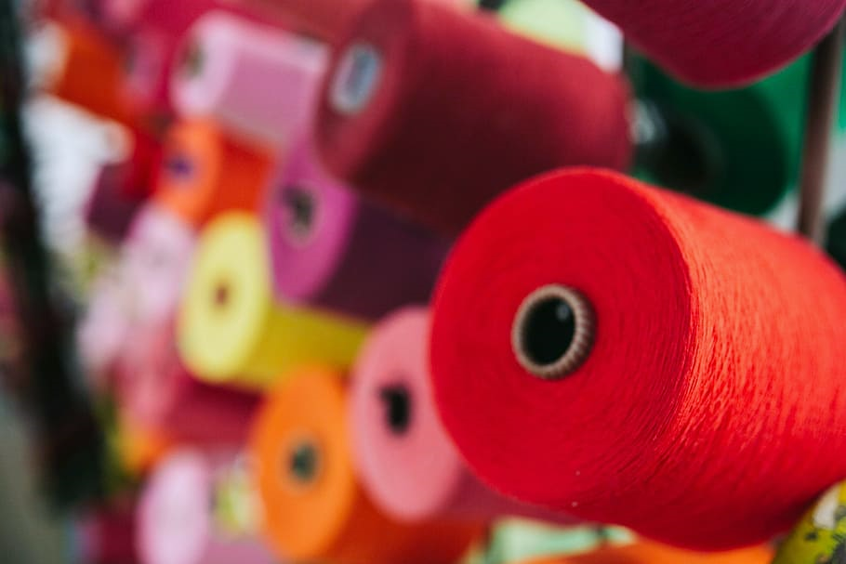
VENUS
HANDI-CRAFTS
A Company Incepted In 1972

Slide 2
Group Members
Name:
Student IDs:
Zohaib Moosani
Shibli Zahid
Muhammad Amin
Student 1333277
Student 1333537
Student 1333509

Slide 3
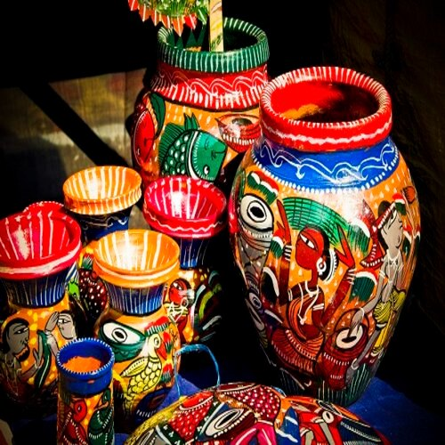
Problem
Statement:
Venus Handicrafts is certified company engaged in manufacturing and exporting of Decorative Handicrafts to global importers, wholesalers and retailers since 1972. The ever-increasing acceptance of our products on global platform highlights our market presence and goodwill. The company has maintained its market value throughout the world. To enhance its value the organization wants to change the look and feel of the website for which they have approached us.

Slide 4
Requirement Specifications:
1) The Home Page should be created with proper sections, graphics and with a suitable logo.
2) Link on the home page must be included such as Home, About us, Gallery, Contact information, Handicrafts products.
3) The look and feel of the project must be made user friendly and uniformity in the color combination must be maintained.
4) Handicrafts such as:
- Iron Handicrafts
- Glass Handicrafts
- Brass Handicrafts
- Wood Handicrafts
- Aluminum Handicrafts
- Handicraft Decorative
- Tables wares
- Home Décor
- Candle Accessories
And other additional products
5) Navigation of the project must be made smooth.
6) Site Map
7) Gallery
8) FAQs

Slide 5
Work Distribution

Slide 6
Thank You!

